Slide 1
Graphics & Animation
Can provide humor
Gets attention

Slide 2
PRESENTED BY AND DESIGNED
Presentation Point check out link below for more presentations (www.presentationpoint.yolasite.com)
IDEA BY:
FUTURE IT (www.futureit.yolasite.com)
SUPPORTED BY:
www.exploretomorrow.blogspot.com

Slide 3
Graphics & Animation

Slide 4
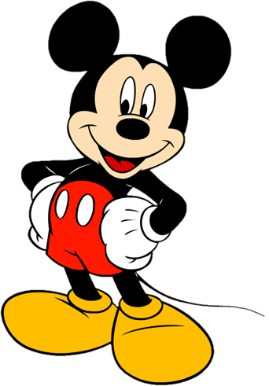
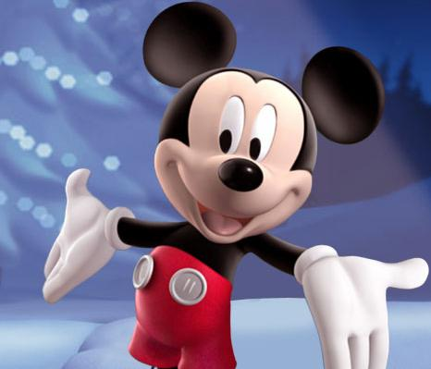
What is Animation?
50 years ago Walt Disney created animated objects such as Mickey Mouse.
Today the process used to create animated objects has had to change.
In fact, it continues to change.

Slide 5
Animation
The word “animation” is a form of “animate,” which means to bring to life.
Thus when a multimedia developer wants to bring an image to life, animation is used.
For example, a spinning globe is it better to film the motion on video, or is animation a better solution.

Slide 6
The Power of Motion
Visual effects such as wipes, fades, zooms, and dissolves are available in most authoring packages.
But animation is more than wipes, fades, zooms, and dissolves.
Until Quick Time and AVI motion video became more common place animations were the primary source of dynamic action in multimedia.

Slide 7
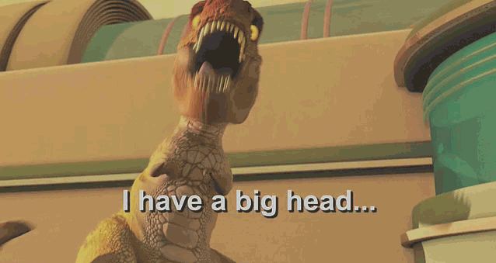
Animation
Add visual impacts to your multimedia projects and Web pages. Many multimedia applications provide animation tools.
You just have to look at it & enjoy it!

Slide 8
Principles of Animation
Animation is possible because of a a biological phenomenon known as persistence of vision
And
The psychological phenomenon called phi .
An object seen by the human eye remains chemically mapped on the eye’s retina for a brief time after viewing.
Combined with the human mind’s need to conceptually complete a perceived action.
This makes it possible for a series of images that are changed very slightly and very rapidly, one after the other, seem like continuous motion .

Slide 9
Animation
Animation adds visual impact. Persistence of vision allows a series of separate images to blend together into a visual illusion of movement.

Slide 10
Animation and Frame Rates
TV video builds 30 entire frames or pictures every second.
Movies are shot at a shutter rate of 24 frames per second, but using projections tricks the flicker is increased to 48.
On some projectors each frame is shown 3 times before the next frame, for a total of 72 flickers per second which helps eliminate the flicker effect.
Cel Animation – plays at 24 frames per second.

Slide 11
Computer Animation
Typically employees the same logic and procedural concepts as cell animation.
You can usually set your own frame rate .
At 15 frames a second the animation may appear jerky and slow.
2-D animation can be an acceptable alternative to the expense of creating video

Slide 12
3-D Animation
3-D Animation involves three steps: modeling, animation, and rendering
Modeling – the process of creating objects and scenes
Animation – the process of defining the object’s motion
Rendering – the final step in creating 3-D animation.
Morphing is the process of blending two images into a series of images
Warping allows you to distort a single image
Virtual reality (VR) creates an environment that surrounds the user so that they become part of the experience.

Slide 13
Animation File Formats
Software File Format
Director .dir & .dcr
Animator Pro .fli
Studio Max .max
SuperCard and Director .pics
Windows Audio Video Interleaved .avi
Macintosh .qt & .mov
Motion Video .mpeg
CompuServe .gif
Flash .swf
Shockwave .dcr

Slide 14
Graphics
Images created with the help of computers.
2-D and 3-D (displayed on a 2-D screen but in such a way that they give an illusion of depth).
Used for scientific research, artistic expression, or for industrial applications.
Graphics have made the computer interfaces more intuitive by removing the need to memorize commands.

Slide 15
Displaying Images
Most all computer displays consist of a grid of tiny pixels arranged in a regular grid of rows and columns.
Images are displayed by assigning different colors to the pixels located in the desired portion of the computer display.
Let’s discuss the pixel a bit more …

Slide 16
Pixel
The smallest image forming element on a computer display.
The computer display is made up of a regular grid of these pixels.
The computer has the capability of assigning any color to any of the individual pixels on the display.
Let’s now see how the computer displays a square.

Slide 18
Dithering
In this scheme, pixels of alternating colors are used to simulate a color that is not present in the platelet.
For example, red and green pixels can be alternated to give the impression of bright yellow.
The quality of the displayed image is poorer.

Slide 19
Aliasing
The computer screen consists of square-ish pixels arranged in a fixed grid.
At times, when a diagonal line is drawn on this grid, it looks more like a staircase, instead of a straight line.
This effect – called aliasing – can be managed by reducing the size of pixels.

Slide 20
Anti-Aliasing
Anti-aliasing is another technique used for managing the ‘staircase’ effect.
Let’s say that we need to draw a white straight-line such that it overlaps 60% with one pixel, and 40% with another initially, and near the end, 58%, 41%, and 1%, respectively, with three pixels.

Slide 21
Graphics File Formats
The choice of the format generally depends upon the nature of the image. For example:
An image of natural scenery contains many irregular, non-gemetric shapes, therefore is stored in bit-map format.
A CAD drawing consists of many geometric shapes like straight lines, arcs, etc. and therefore is stored in a vector format.
A third situation arises when dealing with graphics that contain both regular and irregular shapes.

Slide 22
Vector or Object-Oriented Graphics
Treats everything that is drawn as an object
Objects retain their identity after they are drawn
These objects can later be easily moved, stretched, duplicated, deleted, etc
Are resolution independent
Relatively small file size
Examples: swf, svg, wmf, ps

Slide 23
Image Processing
A branch of computer science concerned with manipulating and enhancing computer graphics
Examples:
Converting 2-D satellite imagery into a 3-D model of a terrain
Restoring old, faded photographs into something closer to the original
Determining the amount of silting in Tarbela lake from a satellite image

Slide 24
3-D Graphics
Flat images enhanced to impart the illusion of depth.
We perceive the world and the objects in it in 3-D - breadth, width, depth - although the images formed on the retinas of our eyes are 2-D.
The secret of 3-D perception: stereo vision.

Slide 25
3-D Graphics
The two eyes are spaced a few cm apart.
Result: The images formed on the two retinas are slightly different.
The brain combines these two into a single 3-D image, enabling us to perceive depth.

Slide 26
3-D Graphics: Applications
Games
Medical images
3-D CAD

Slide 27
3-D Rendering
The process of converting information about 3-D objects into a bit-map that can be displayed on a 2-D computer display
Computationally, very expensive!
Steps:
Draw the wire-frame (skeleton, made with thin lines)
Fill with colors, textures, patterns
Add lighting effects (reflections, shadows)

Slide 29
1
2
3
4
5
6
7
8
9
11
12
13
10
14
15
16

Slide 30
Computer Animation: Examples
Games
Cartoons, movies
Visualization of processes, e.g the IM process
Displaying the results of scientific experiments, e.g. nuclear fusion.

Slide 31
Tweening
Creating a reasonable illusion of motion requires the drawing of 14-30 images per second of animation – very tedious!
In practice, only 4-5 images (called key images) instead of 14-30 are drawn, and then the computer is asked to create the remaining in-between images.

Slide 32
Tweening
This process of creating these in-between images from key images is called in-betweening (or tweening for short).
The simplest algorithm for tweening calculates the position of a particular segment of an image by calculating the average of the positions of that same image segment belonging to adjacent key images.

Slide 33
Future of Graphics & Animation
New graphic-file storage formats will appear with better compression efficiencies.
3-D animation will become more popular as computers become faster and algorithms become smarter.
More realistic games; better realism in movies – may, one day, make the human actors extinct.

